Slide 1


sss
IMPLEMENTING AN OAUTH 2 AUTHORIZATION SERVER WITH SPRING SECURITY
The New Way

Slide 2






laurspilca.com/blog
youtube.com/c/laurentiuspilca
@laurspilca
Laurentiu Spilca
Notes:
Elements (version 1)
Elements are used to give more detail to a set of ideas, they should all relate to the same topic.
For example, use this page for a list of deliverables, key roles on a project, phases of a project, or any topic that can be broken down into more specific examples.
Each section should have an icon that relates to the content of that specific element, no icon should be repeated on the same page, and they should all be the same colour.
Keep the text to 1-2 sentences and aim to have about the same amount of content under each element.

Slide 3

Notes:
Elements (version 1)
Elements are used to give more detail to a set of ideas, they should all relate to the same topic.
For example, use this page for a list of deliverables, key roles on a project, phases of a project, or any topic that can be broken down into more specific examples.
Each section should have an icon that relates to the content of that specific element, no icon should be repeated on the same page, and they should all be the same colour.
Keep the text to 1-2 sentences and aim to have about the same amount of content under each element.

Slide 4

1
Notes:
Chapter Intro Slide (version P)
This slide should be used at the beginning of each “chapter” of your presentation (as introduced in the Agenda slide) to keep the audience aware of their place in the story and to help break things up. Change the text and chapter number accordingly. If you do not need a sub-head (the smaller text), delete it. Use different backgrounds for different chapter titles, try not to repeat a background.
Very short presentations (< ~10 slides) may not need Chapter Intro Slides.
There are multiple versions of this template with various white and black background images starting on slide 10.

Slide 5
Spring Security.
1
Notes:
Chapter Intro Slide (version P)
This slide should be used at the beginning of each “chapter” of your presentation (as introduced in the Agenda slide) to keep the audience aware of their place in the story and to help break things up. Change the text and chapter number accordingly. If you do not need a sub-head (the smaller text), delete it. Use different backgrounds for different chapter titles, try not to repeat a background.
Very short presentations (< ~10 slides) may not need Chapter Intro Slides.
There are multiple versions of this template with various white and black background images starting on slide 10.

Slide 6

The new authorization server project.
1
Notes:
Chapter Intro Slide (version P)
This slide should be used at the beginning of each “chapter” of your presentation (as introduced in the Agenda slide) to keep the audience aware of their place in the story and to help break things up. Change the text and chapter number accordingly. If you do not need a sub-head (the smaller text), delete it. Use different backgrounds for different chapter titles, try not to repeat a background.
Very short presentations (< ~10 slides) may not need Chapter Intro Slides.
There are multiple versions of this template with various white and black background images starting on slide 10.

Slide 7

https://github.com/spring-projects/spring-authorization-server
Support policy
https://github.com/spring-projects/spring-authorization-server/blob/main/SUPPORT_POLICY.adoc
1
Notes:
Chapter Intro Slide (version P)
This slide should be used at the beginning of each “chapter” of your presentation (as introduced in the Agenda slide) to keep the audience aware of their place in the story and to help break things up. Change the text and chapter number accordingly. If you do not need a sub-head (the smaller text), delete it. Use different backgrounds for different chapter titles, try not to repeat a background.
Very short presentations (< ~10 slides) may not need Chapter Intro Slides.
There are multiple versions of this template with various white and black background images starting on slide 10.

Slide 8
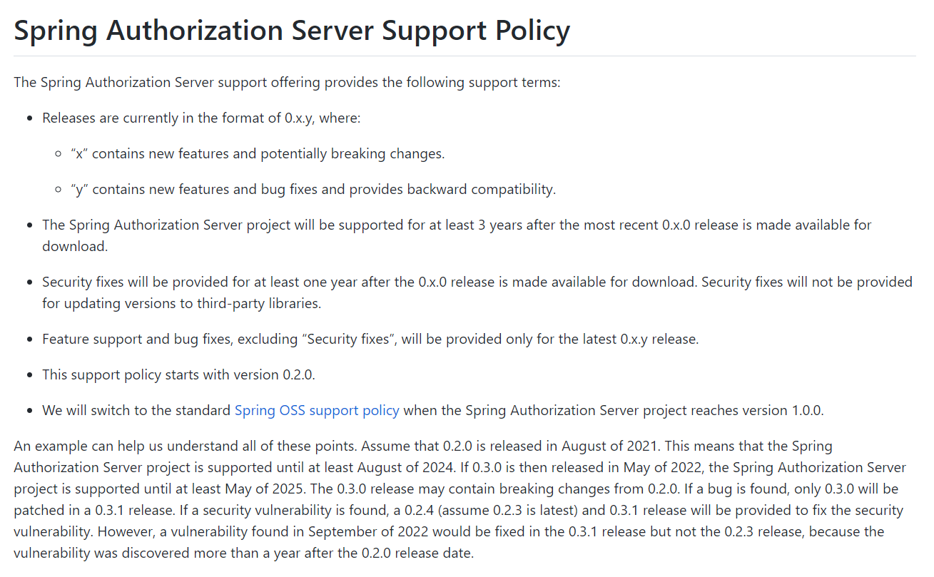
1
Notes:
Chapter Intro Slide (version P)
This slide should be used at the beginning of each “chapter” of your presentation (as introduced in the Agenda slide) to keep the audience aware of their place in the story and to help break things up. Change the text and chapter number accordingly. If you do not need a sub-head (the smaller text), delete it. Use different backgrounds for different chapter titles, try not to repeat a background.
Very short presentations (< ~10 slides) may not need Chapter Intro Slides.
There are multiple versions of this template with various white and black background images starting on slide 10.

Slide 9
Before trying it…
1
Notes:
Chapter Intro Slide (version P)
This slide should be used at the beginning of each “chapter” of your presentation (as introduced in the Agenda slide) to keep the audience aware of their place in the story and to help break things up. Change the text and chapter number accordingly. If you do not need a sub-head (the smaller text), delete it. Use different backgrounds for different chapter titles, try not to repeat a background.
Very short presentations (< ~10 slides) may not need Chapter Intro Slides.
There are multiple versions of this template with various white and black background images starting on slide 10.

Slide 10
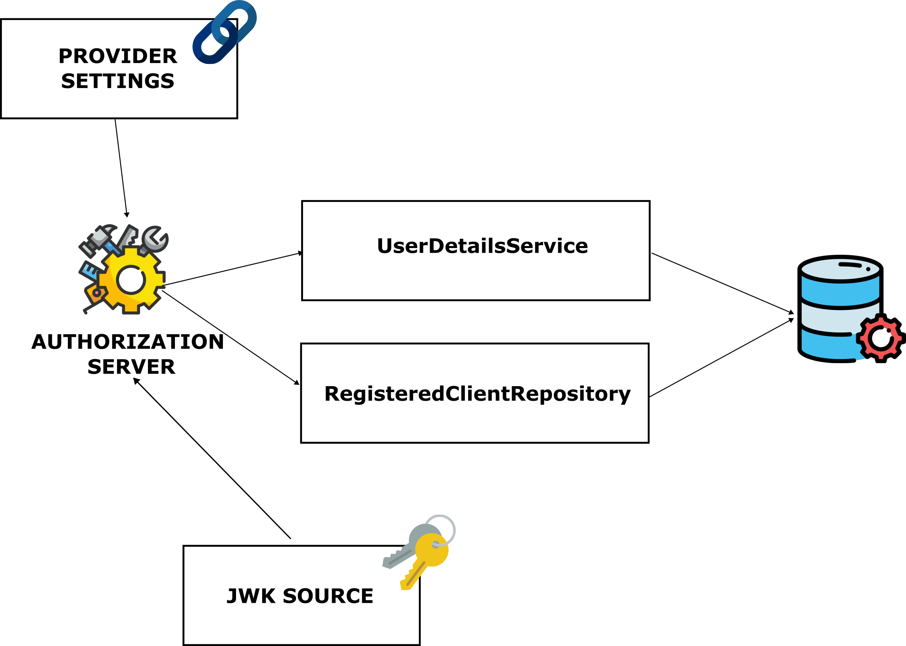
1
Notes:
Chapter Intro Slide (version P)
This slide should be used at the beginning of each “chapter” of your presentation (as introduced in the Agenda slide) to keep the audience aware of their place in the story and to help break things up. Change the text and chapter number accordingly. If you do not need a sub-head (the smaller text), delete it. Use different backgrounds for different chapter titles, try not to repeat a background.
Very short presentations (< ~10 slides) may not need Chapter Intro Slides.
There are multiple versions of this template with various white and black background images starting on slide 10.

Slide 11
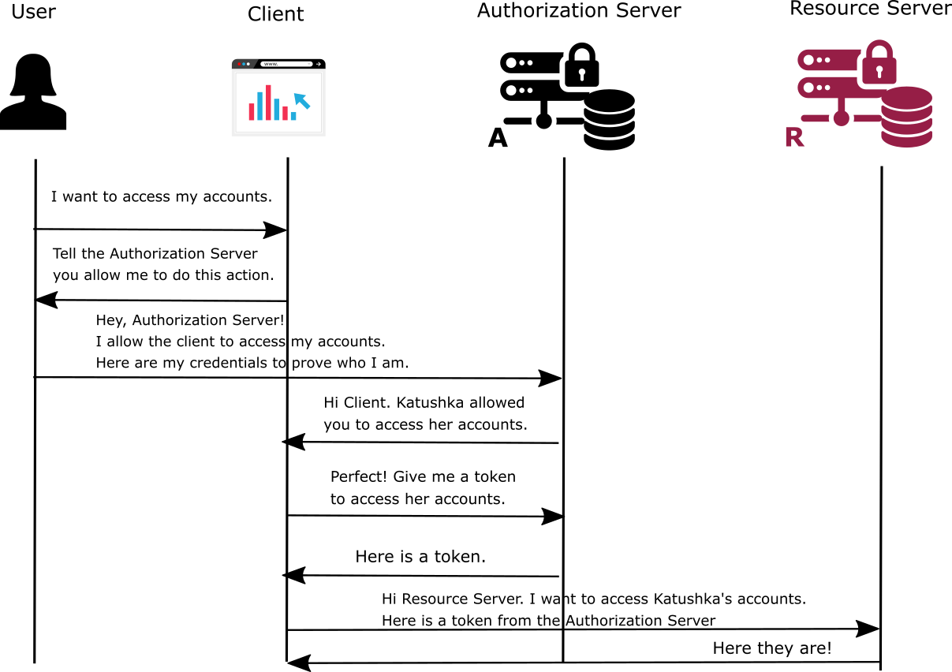

Authorization Code
1
Notes:
Chapter Intro Slide (version P)
This slide should be used at the beginning of each “chapter” of your presentation (as introduced in the Agenda slide) to keep the audience aware of their place in the story and to help break things up. Change the text and chapter number accordingly. If you do not need a sub-head (the smaller text), delete it. Use different backgrounds for different chapter titles, try not to repeat a background.
Very short presentations (< ~10 slides) may not need Chapter Intro Slides.
There are multiple versions of this template with various white and black background images starting on slide 10.

Slide 12
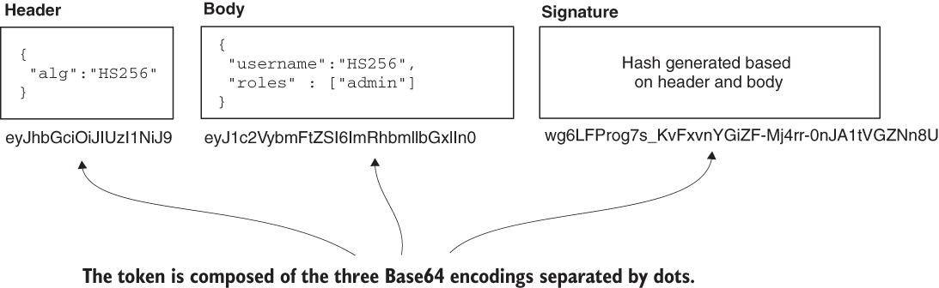
JSON Web Token.
1
Notes:
Chapter Intro Slide (version P)
This slide should be used at the beginning of each “chapter” of your presentation (as introduced in the Agenda slide) to keep the audience aware of their place in the story and to help break things up. Change the text and chapter number accordingly. If you do not need a sub-head (the smaller text), delete it. Use different backgrounds for different chapter titles, try not to repeat a background.
Very short presentations (< ~10 slides) may not need Chapter Intro Slides.
There are multiple versions of this template with various white and black background images starting on slide 10.

Slide 13
Let’s try it…
1
Notes:
Chapter Intro Slide (version P)
This slide should be used at the beginning of each “chapter” of your presentation (as introduced in the Agenda slide) to keep the audience aware of their place in the story and to help break things up. Change the text and chapter number accordingly. If you do not need a sub-head (the smaller text), delete it. Use different backgrounds for different chapter titles, try not to repeat a background.
Very short presentations (< ~10 slides) may not need Chapter Intro Slides.
There are multiple versions of this template with various white and black background images starting on slide 10.

Slide 14


manning.com
ctwjbcn22
1
Notes:
Chapter Intro Slide (version P)
This slide should be used at the beginning of each “chapter” of your presentation (as introduced in the Agenda slide) to keep the audience aware of their place in the story and to help break things up. Change the text and chapter number accordingly. If you do not need a sub-head (the smaller text), delete it. Use different backgrounds for different chapter titles, try not to repeat a background.
Very short presentations (< ~10 slides) may not need Chapter Intro Slides.
There are multiple versions of this template with various white and black background images starting on slide 10.

Slide 15
1
Notes:
Chapter Intro Slide (version P)
This slide should be used at the beginning of each “chapter” of your presentation (as introduced in the Agenda slide) to keep the audience aware of their place in the story and to help break things up. Change the text and chapter number accordingly. If you do not need a sub-head (the smaller text), delete it. Use different backgrounds for different chapter titles, try not to repeat a background.
Very short presentations (< ~10 slides) may not need Chapter Intro Slides.
There are multiple versions of this template with various white and black background images starting on slide 10.

Slide 16
laurspilca.com/blog
youtube.com/c/laurentiuspilca
@laurspilca
Laurentiu Spilca
Notes:
Elements (version 1)
Elements are used to give more detail to a set of ideas, they should all relate to the same topic.
For example, use this page for a list of deliverables, key roles on a project, phases of a project, or any topic that can be broken down into more specific examples.
Each section should have an icon that relates to the content of that specific element, no icon should be repeated on the same page, and they should all be the same colour.
Keep the text to 1-2 sentences and aim to have about the same amount of content under each element.

